Slide 1
Object-Oriented Systems
CS60059
Dr. RAJIB MALL
Professor
Department Of Computer Science & Engineering
IIT Kharagpur.

Slide 2

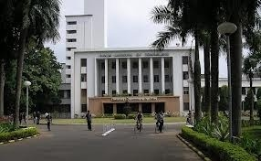
About The Instructor
RAJIB MALL
B.E. , M.E., Ph.D from Indian Institute of Science, Bangalore
Worked with Motorola (India)
  Senior engineer and later as project manager
Shifted to IIT, Kharagpur in 1994
  Currently Professor

Slide 3
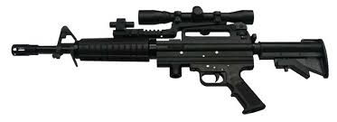

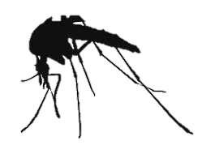

Motivation for Doing this Course
You have got a sophisticated gun
You are the proud owner of the nice gun!
Wanted to use it…
Opportunity came …
You claimed you are good at using your gun!

Slide 4
Motivation cont…
You learnt Java, C++, …
You know the syntax and semantics well.
You have written small programs that work.
You claimed you are an expert object-oriented software developer!!
This syndrome is not restricted to students alone…

Slide 5
Plan of The Course
Basic concepts
UML
Designing using UML
Testing OO programs
Object-oriented principles
Patterns
≈ 40%
?
≈ 5%
≈ 55%

Slide 6
Grading
Class Test 1 --- End Aug 10%
Mid Sem --- End Sep 25%
Class Test 2 --- End Oct 10%
End Sem --- End Nov 50%
Class attendance + Participation -- 5%
Bonus (Extra Marks) --- ???

Slide 7
Introduction
Object-oriented design (OOD) techniques are now extremely popular:
  Inception in early 1980’s and nearing maturity.
  Widespread acceptance in industry and academics.
  Unified Modelling Language (UML) became an ISO standard (ISO/IEC 19501) in 2004.

Slide 8






Schematic Object-Oriented Solution for LIS
reference-books
members
issue-books
controller

Slide 9

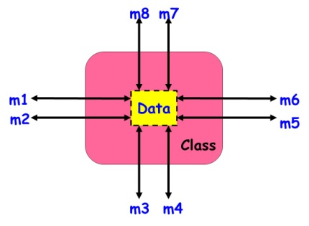
Object-Oriented Development
A system is designed as a set of interacting objects.
Objects are often real-world entities:
    Examples: an employee, a book etc.
  Can also be conceptual objects :
    Controller, manager, etc.
An object consists of data (attributes) and functions (methods) that operate on data.
  Encapsulation.

Slide 10
Class Diagram

Slide 11


Class
Template for object creation:
  Instantiated into objects
Examples: Employee, Book, etc.
Sometimes not intended to produce instances:
  Abstract classes

Slide 12
UML Class Representation
A class represents a set of objects having similar attributes, operations, relationships and behavior.
Class Name
Can it have any attributes not explicitly declared?
Window
size: Size
visibility: boolean
Attributes
A class can implicitly have a few association attributes…
display()
hide()
Operations

Slide 13
Alternate Representations of a Class in UML
LibraryMember
LibraryMember
LibraryMember
Member Name
Membership Number
Address
Phone Number
E-Mail Address
Membership Admission Date
Membership Expiry Date
Books Issued
issueBook( );
findPendingBooks( );
findOverdueBooks( );
returnBook( );
findMembershipDetails( );
Why?
issueBook( );
findPendingBooks( );
findOverdueBooks( );
returnBook( );
findMembershipDetails( );
Attributes

Slide 14
Class Attribute Examples
Java Syntax | UML Syntax
Date birthday | birthday:Date
Public int duration=100 | +duration:int = 100
Private Student students[0..MAX_Size] | -students[0..MAX_Size]:Student

Slide 15
Visibility of Class of Members
Visibilty | Java Syntax | UML Syntax
public | public | +
protected | protected | #
package |  | ~
private | private | -
?

Slide 16
Methods
Methods are the operations supported by an object:
  Means for manipulating the data of an object.
  Invoked by sending a message (method call).
  Examples: calculate_salary(), issue-book(), getMemberDetails(), etc.
Window
size: Size
visibility: boolean
display()
hide()

Slide 17
Method Examples
Java Syntax | UML Syntax?
void move(int dx, int dy) | ~move(int dx,int dy)
public int getSize() | +int getSize()

Slide 18
Are Methods and Messages Synonyms?
No
Message was the original concept in object-orientation…
Methods are the later simplifications…
Sometimes used as synonyms

Slide 19
Are Methods and Operations Synonyms?
No
An operation can be implemented by multiple methods.
  Known as polymorphism
  In the absence of polymorphism-–the two terms are synonyms.

Slide 20
